Slide 1
Notes of Deep Learning
[1]
Part I (chapter 2-5)
[1] Goodfellow, I., Bengio, Y., & Courville, A. (2016). Deep Learning. The MIT Press.

Slide 2
Part I: Applied Math and Machine Learning Basics
Chapter 2. Linear algebra
Chapter 3. Probability and information theory
Chapter 4. Numerical computation
Chapter 5. Machine learning basics

Slide 3
Part I: Applied Math and Machine Learning Basics
Chapter 3. Probability and information theory

Slide 4
Probability and Information Theory
In AI applications, we use probability theory in two major ways:
The laws or probability tell us how AI systems should reason, so we design our algorithms to compute or approximate various expressions derived using probability theory.
We can use probability and statistics to theoretically analyze the behavior of proposed AI system.
Probability theory allows us to make uncertain statements and reason in the presence of uncertainty
Information allows us to quantify the amount of uncertainty in a probability distribution

Slide 5
Probability and Information Theory
Three possible sources of uncertainty:
Inherent stochasticity in the system being modeled
Incomplete observability
Incomplete modeling
Frequentist probability:
rates at which events occur(frequencies of events)
Bayesian probability:
qualitative levels of certainty(degree of belief)
Treat Bayesian probabilities as behaving exactly the same as frequentist probabilities.
Probability can be seen as the extension of logic to deal with uncertainty.

Slide 6

Probability and Information Theory
Random variables:
Notations: $x=x_{1}$, $x=x$
Probability distribution:
A description of how likely a random variable or set of random variables is to take on each of its possible states.

Slide 7
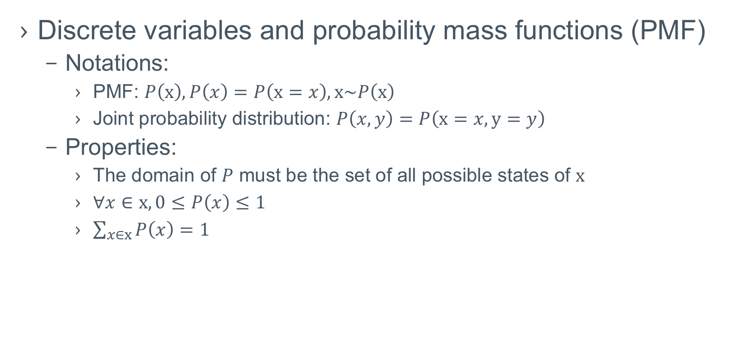
Probability and Information Theory
Discrete variables and probability mass functions (PMF)
Notations:
PMF: $P\left(x\right), P\left(x\right)=P\left(x=x\right), x\sim P\left(x\right)$
Joint probability distribution: $P\left(x,y\right)=P\left(x=x, y=y\right)$
Properties:
The domain of $P$ must be the set of all possible states of $x$
$∀x∈x, 0≤P\left(x\right)≤1$
$\sum_{x∈x}{P\left(x\right)}=1$

Slide 8
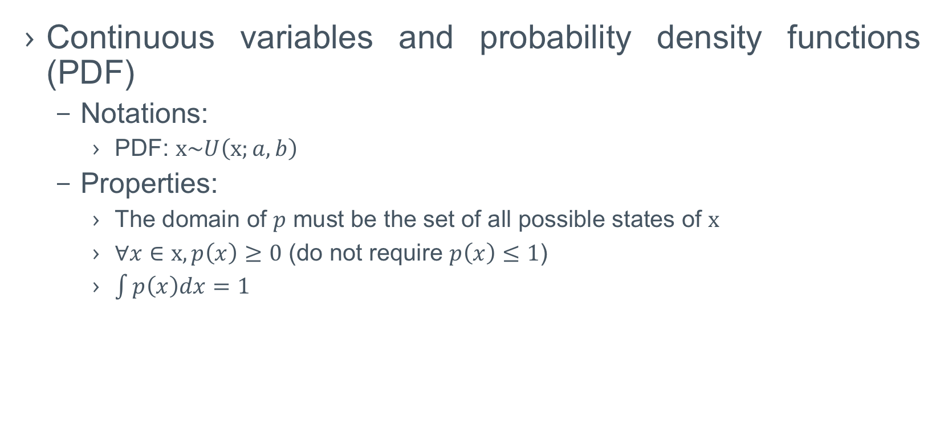
Probability and Information Theory
Continuous variables and probability density functions (PDF)
Notations:
PDF: $x\sim U\left(x;a,b\right)$
Properties:
The domain of $p$ must be the set of all possible states of $x$
$∀x∈x, p\left(x\right)≥0$ (do not require $p\left(x\right)≤1$)
$\int{p\left(x\right)dx}=1$

Slide 9
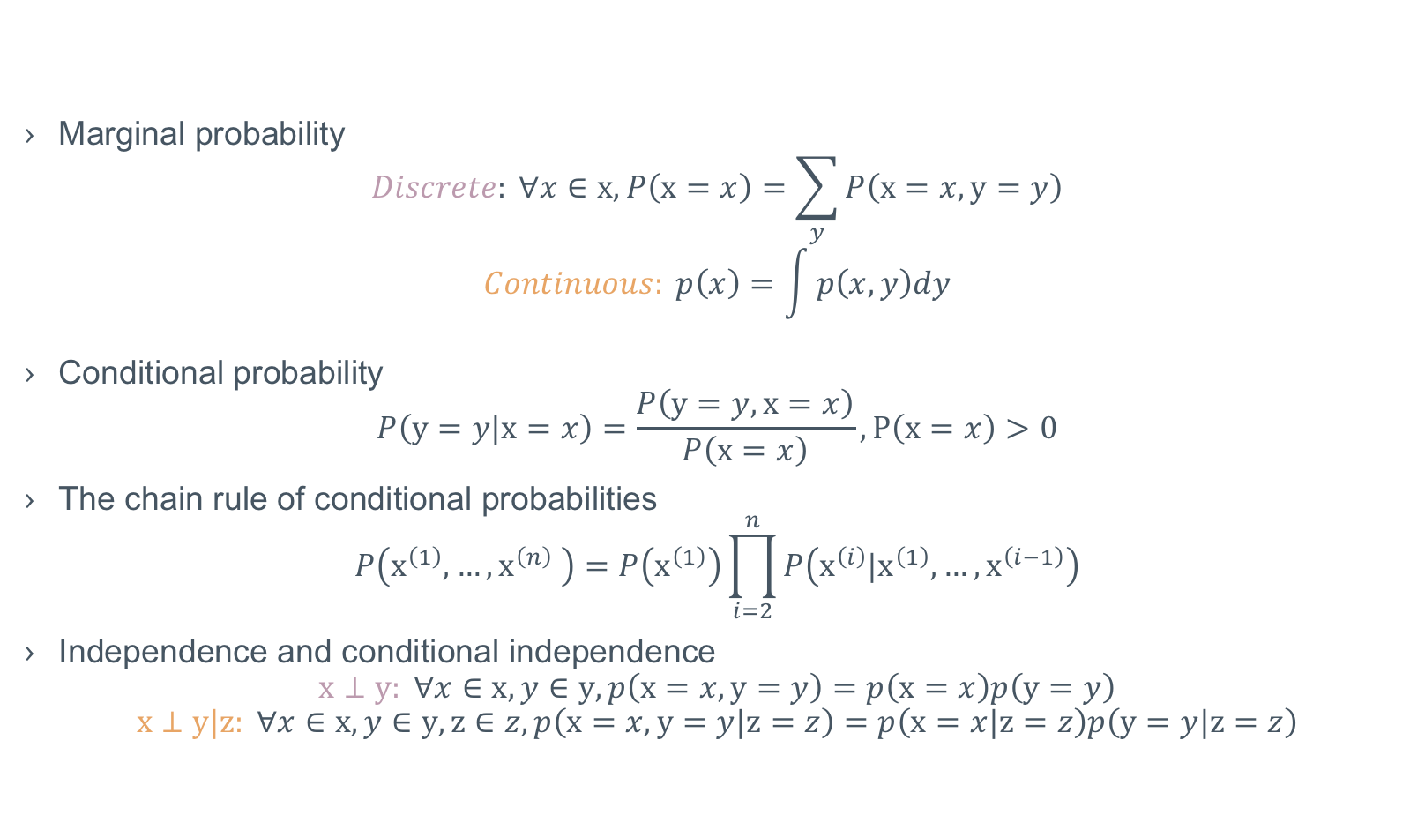
Probability and Information Theory
Marginal probability
$$Discrete: ∀x∈x, P\left(x=x\right)=\sum_{y}{P\left(x=x,y=y\right)}$$
$$Continuous: p\left(x\right)=\int{p\left(x,y\right)dy}$$
Conditional probability
$$P\left(y=y|x=x\right)=\frac{P\left(y=y,x=x\right)}{P\left(x=x\right)}, P\left(x=x\right)>0$$
The chain rule of conditional probabilities
$$P\left(x^{\left(1\right)},…,x^{\left(n\right)} \right)=P\left(x^{\left(1\right)}\right)\prod_{i=2}^{n}{P\left(x^{\left(i\right)}|x^{\left(1\right)},…,x^{\left(i−1\right)}\right)}$$
Independence and conditional independence
$$x⊥y: ∀x∈x,y∈y, p\left(x=x,y=y\right)=p\left(x=x\right)p\left(y=y\right)$$
$$x⊥y|z: ∀x∈x,y∈y,z∈z,p\left(x=x,y=y|z=z\right)=p\left(x=x|z=z\right)p\left(y=y|z=z\right)$$

Slide 10
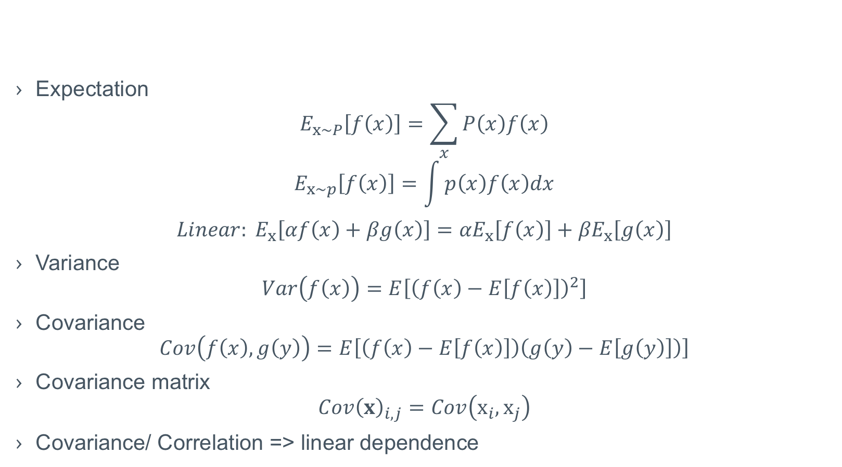
Probability and Information Theory
Expectation
$$E_{x\sim P}\left[f\left(x\right)\right]=\sum_{x}{P\left(x\right)f\left(x\right)}$$
$$E_{x\sim p}\left[f\left(x\right)\right]=\int{p\left(x\right)f\left(x\right)dx}$$
$${Linear: E}_{x}\left[αf\left(x\right)+βg\left(x\right)\right]={αE}_{x}\left[f\left(x\right)\right]+{βE}_{x}\left[g\left(x\right)\right]$$
Variance
$$Var\left(f\left(x\right)\right)=E\left[{\left(f\left(x\right)−E\left[f\left(x\right)\right]\right)}^{2}\right]$$
Covariance
$$Cov\left(f\left(x\right),g\left(y\right)\right)=E\left[\left(f\left(x\right)−E\left[f\left(x\right)\right]\right)\left(g\left(y\right)−E\left[g\left(y\right)\right]\right)\right]$$
Covariance matrix
$${Cov\left(x\right)}_{i,j}=Cov\left(x_{i},x_{j}\right)$$
Covariance/ Correlation => linear dependence

Slide 11
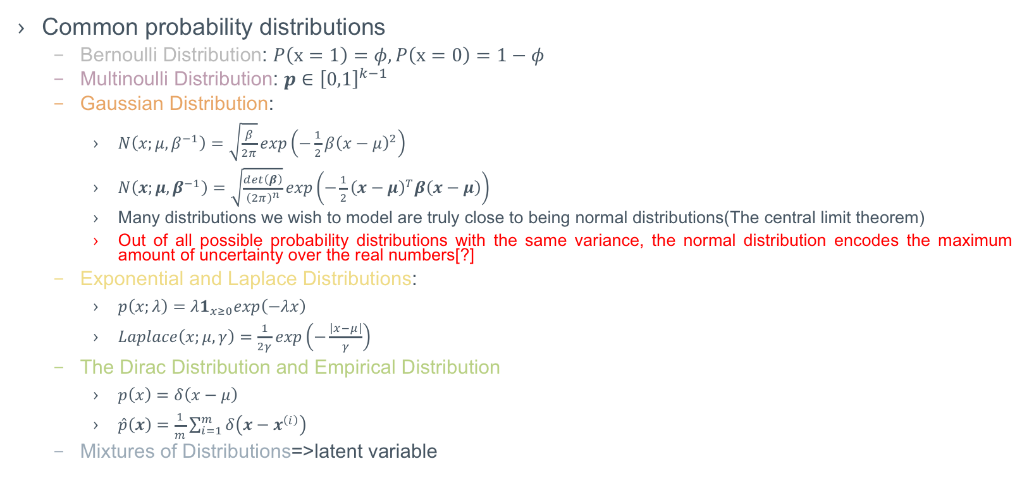
Probability and Information Theory
Common probability distributions
Bernoulli Distribution: $P\left(x=1\right)=φ,P\left(x=0\right)=1−φ$
Multinoulli Distribution: $p∈{\left[0,1\right]}^{k−1}$
Gaussian Distribution:
$N\left(x;μ,β^{−1}\right)=\sqrt{\frac{β}{2π}}exp\left(−\frac{1}{2}β{\left(x−μ\right)}^{2}\right)$
$N\left(x;μ,β^{−1}\right)=\sqrt{\frac{det\left(β\right)}{{\left(2π\right)}^{n}}}exp\left(−\frac{1}{2}{\left(x−μ\right)}^{T}β\left(x−μ\right)\right)$
Many distributions we wish to model are truly close to being normal distributions(The central limit theorem)
Out of all possible probability distributions with the same variance, the normal distribution encodes the maximum amount of uncertainty over the real numbers[?]
Exponential and Laplace Distributions:
$p\left(x;λ\right)=λ1_{x≥0}exp\left(−λx\right)$
$Laplace\left(x;μ,γ\right)=\frac{1}{2γ}exp\left(−\frac{\left|x−μ\right|}{γ}\right)$
The Dirac Distribution and Empirical Distribution
$p\left(x\right)=δ\left(x−μ\right)$
$\hat{p}\left(x\right)=\frac{1}{m}\sum_{i=1}^{m}{δ\left(x−x^{\left(i\right)}\right)}$
Mixtures of Distributions=>latent variable

Slide 12

Probability and Information Theory
Useful properties of common functions
Logistic sigmoid: $σ\left(x\right)=\frac{1}{1+exp\left(−x\right)}$
Ranges from $\left(0,1\right)$
Saturate: when its argument is very positive or very negative, the function becomes very flat and insensitive to small changes in its input
Softplus: $ζ\left(x\right)=log\left(1+exp\left(x\right)\right)$
Ranges from $\left(0,∞\right)$
A smoothed version of $x^{+}=max\left(0,x\right)$
Properties
$σ\left(x\right)=\frac{exp\left(x\right)}{exp\left(x\right)+exp\left(0\right)}$
$\frac{d}{dx}σ\left(x\right)=σ\left(x\right)\left(1−σ\left(x\right)\right)$
1- $σ\left(x\right)$= $σ\left(−x\right)$
$logσ\left(x\right)=−ζ\left(−x\right)$
$\frac{d}{dx}ζ\left(x\right)=σ\left(x\right)$
$∀x∈\left(0,1\right), σ^{−1}\left(x\right)=log\left(\frac{x}{1−x}\right)$ => logit
$∀x>0,ζ^{−1}\left(x\right)=log\left(exp\left(x\right)−1\right)$
$ζ\left(x\right)=\int_{−∞}^{x}{σ\left(y\right)dy}$
$ζ\left(x\right)−ζ\left(−x\right)=x$

Slide 13

Probability and Information Theory
Bayes’ rule:
$$P\left(x|y\right)=\frac{P\left(x\right)P\left(y|x\right)}{P\left(y\right)}=\frac{P\left(x\right)P\left(y|x\right)}{\sum_{x}{P\left(y|x\right)P\left(x\right)}}$$

Slide 14
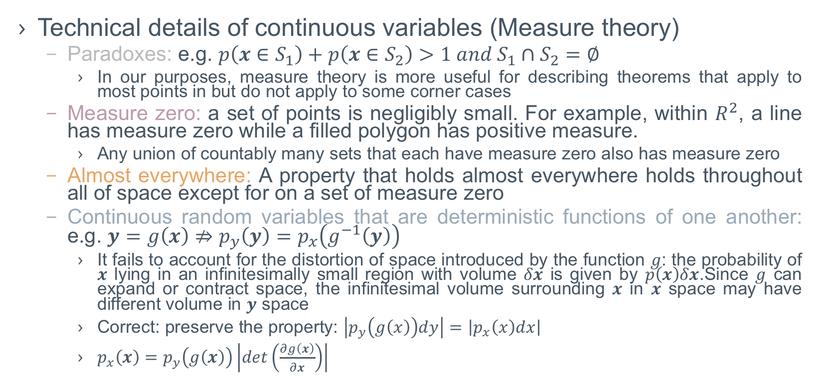
Probability and Information Theory
Technical details of continuous variables (Measure theory)
Paradoxes: e.g. $p\left(x∈S_{1}\right)+p\left(x∈S_{2}\right)>1 and S_{1}∩S_{2}=∅$
In our purposes, measure theory is more useful for describing theorems that apply to most points in but do not apply to some corner cases
Measure zero: a set of points is negligibly small. For example, within $R^{2}$, a line has measure zero while a filled polygon has positive measure.
Any union of countably many sets that each have measure zero also has measure zero
Almost everywhere: A property that holds almost everywhere holds throughout all of space except for on a set of measure zero
Continuous random variables that are deterministic functions of one another: e.g. $y=g\left(x\right)⇏p_{y}\left(y\right)=p_{x}\left(g^{−1}\left(y\right)\right)$
It fails to account for the distortion of space introduced by the function $g$: the probability of $x$ lying in an infinitesimally small region with volume $δx$ is given by $p\left(x\right)δx$.Since $g$ can expand or contract space, the infinitesimal volume surrounding $x$ in $x$ space may have different volume in $y$ space
Correct: preserve the property: $\left|p_{y}\left(g\left(x\right)\right)dy\right|=\left|p_{x}\left(x\right)dx\right|$
$p_{x}\left(x\right)=p_{y}\left(g\left(x\right)\right)\left|det\left(\frac{∂g\left(x\right)}{∂x}\right)\right|$

Slide 15
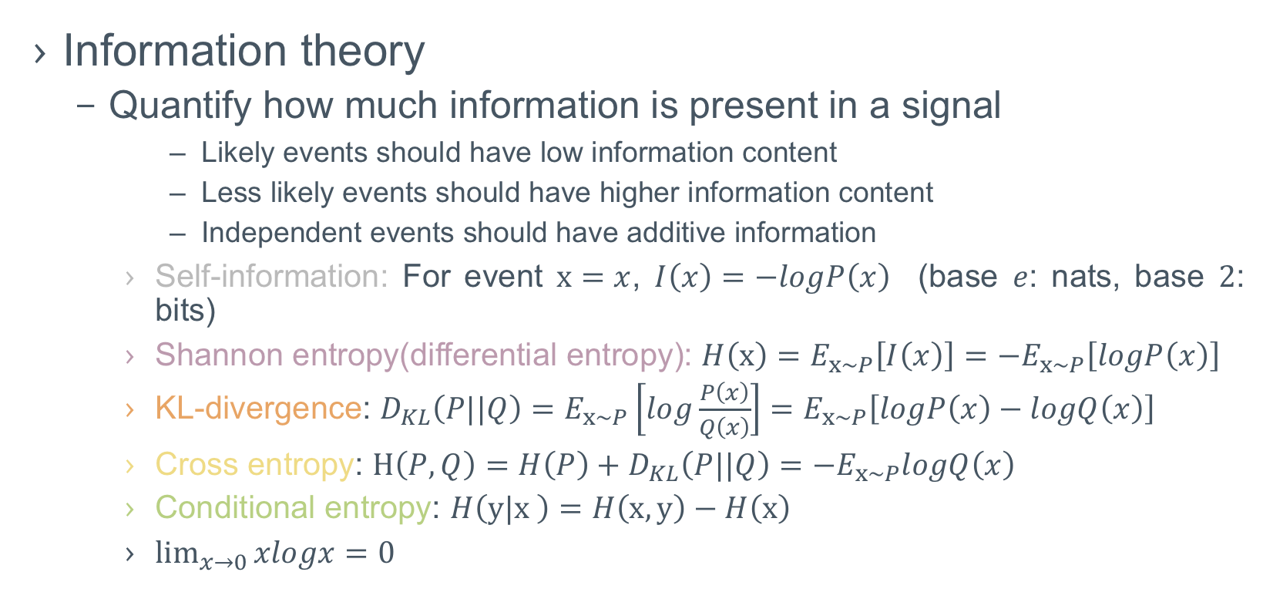
Probability and Information Theory
Information theory
Quantify how much information is present in a signal
Likely events should have low information content
Less likely events should have higher information content
Independent events should have additive information
Self-information: For event $x=x$, $I\left(x\right)=−logP\left(x\right)$ (base $e$: nats, base $2$: bits)
Shannon entropy(differential entropy): $H\left(x\right)=E_{x\sim P}\left[I\left(x\right)\right]=−E_{x\sim P}\left[logP\left(x\right)\right]$
KL-divergence: $D_{KL}\left(P||Q\right)=E_{x\sim P}\left[log\frac{P\left(x\right)}{Q\left(x\right)}\right]=E_{x\sim P}\left[logP\left(x\right)−logQ\left(x\right)\right]$
Cross entropy: $H\left(P, Q\right)=H\left(P\right)+D_{KL}\left(P||Q\right)=−E_{x\sim P}logQ\left(x\right)$
Conditional entropy: $H\left(y|x \right)=H\left(x,y\right)−H\left(x\right)$
$\lim_{x→0}{xlogx}=0$

Slide 16
Probability and Information Theory
Structured probabilistic models / graphical model
Probability distributions involve direct interactions between relatively few variables.
Using a single function to describe the entire joint probability distribution can be very inefficient (both computationally and statistically).
Split a probability distribution into many factors that we multiply together.
Graphical model is a description of a probability distribution.

Slide 17
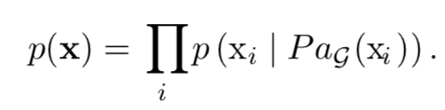
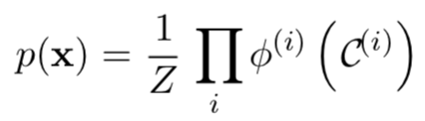
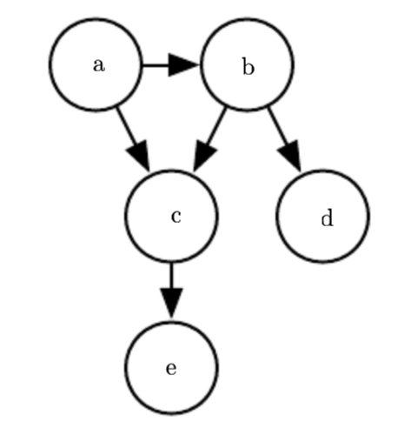
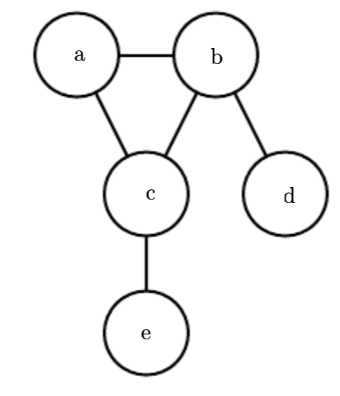
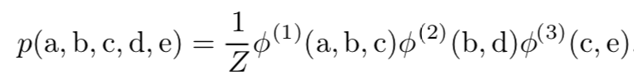
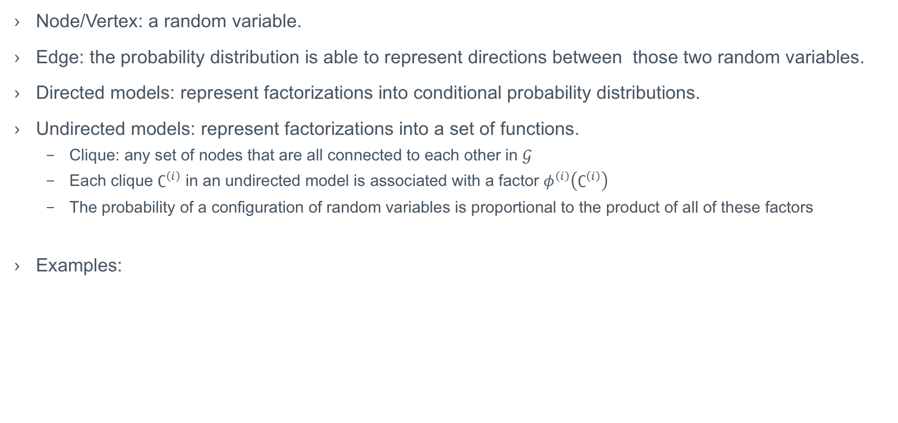
Probability and Information Theory
Node/Vertex: a random variable.
Edge: the probability distribution is able to represent directions between those two random variables.
Directed models: represent factorizations into conditional probability distributions.
Undirected models: represent factorizations into a set of functions.
Clique: any set of nodes that are all connected to each other in $𝒢$
Each clique $∁^{\left(i\right)}$ in an undirected model is associated with a factor $φ^{\left(i\right)}\left(∁^{\left(i\right)}\right)$
The probability of a configuration of random variables is proportional to the product of all of these factors
Examples:
A directed model
A undirected model

Slide 18
To be continued…

